Slide 1
CS 471-1/571
Ch3 The Unified Process

Slide 2
Outline
Introduction to the Unified Process
Phases of the Unified Process
Workflows of the Unified Process
Improving the Software Process

Slide 3
Software Development Best Practices
Develop software iteratively
Manage requirements
Use component-based architectures
Visually model software
    Enable quick/accurate communication
Continuously verify software quality
Control changes to software

Slide 4
Introduction to the Unified Process
Before 1999, three of the most successful object-oriented methodologies:
  Booch’s method
  Jacobson’s Objectory
  Rumbaugh’s OMT
In 1999, they unified the methodologies
  Original name: Rational Unified Process (RUP)
  Next name: Unified Software Development Process (USDP)
  Name used today: Unified Process (for brevity)

Slide 5
Introduction (contd)
The Unified Process is not a series of steps for constructing a software product
  No single “one size fits all” methodology
It is an adaptable methodology
  It has to be modified for the specific product
It is a modeling technique: UML
    A model is a set of UML diagrams that represent various aspects of the software
  OOP is iterative and incremental in nature
Notes:
A picture is worth a thousand words.

Slide 6
Lifecycle: The Four Phases
Major
Milestones
Inception
Elaboration
Construction
Transition
time
  Inception - Define the scope of project
  Elaboration - Plan project, specify features, baseline architecture
  Construction - Build the product
  Transition - Transition the product into the end user

Slide 7
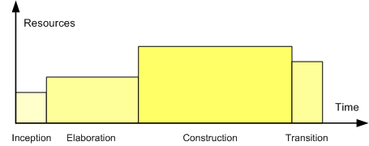
The Four Phases - cont

Slide 8
Phases & Workflows(Disciplines)
time
Phases
Core/Process Workflows
Inception
Elaboration
Construction
Transition
Business Modeling
content
Requirements
Analysis & Design
Implementation
Test
Deployment
Supporting Workflows
Configuration & Change Mgmt
Project Management
Environment
Preliminary
Iteration(s)
Iter.
#1
Iter.
#2
Iter.
#n
Iter.
#n+1
Iter.
#n+2
Iter.
#m
Iter.
#m+1
Iterations
Notes:
An iteration is a distinct sequence of activities based on an established plan and evaluation criteria
A workflow (now called discipline) shows all the activities you might go through to produce a particular set of artifacts.

Slide 9
Phases and Workflows (cont)
In theory, there could be any number of increments
In practice, development seems to consist of four increments
Every step in the Unified Process falls into
  One of the four phases, and also
  One of the core/supporting workflows
Why does each step have to be considered twice?
  Workflow: technical context of a step
  Phase: business context of a step

Slide 10
Inception: Goals
Establishing the scope and boundary conditions:
  An operational vision
  Acceptance criteria
  What is intended to be in the product
  What is not.
Discriminating
  the critical use cases
  the primary scenarios of operation that will drive the major design trade-offs.
Exhibiting at least one candidate architecture against some of the primary scenarios

Slide 11
Inception: Goals (Cont.)
Estimating the overall cost and schedule
  More detailed estimates for the elaboration phase that will immediately follow
Estimating and mitigating potential risks
  Does the team have the necessary experience?
  Is new hardware needed for this product?
  If so, is there a risk that it is not delivered in time?
  If so, is there a way to mitigate that risk, perhaps by ordering back-up hardware from another supplier?
  Are software tools needed and available?
Preparing the supporting environment.

Slide 12
Inception: Risks
Three major risk categories:
  Technical risks
    Hardware, software tools, expertise
  The risk of not getting the requirements right
    Mitigated by performing the requirements workflow correctly
  The risk of not getting the architecture right
    The architecture may not be sufficiently robust
Rank the risks and mitigate the critical risks first

Slide 13
Inception: Essential Activities
Formulating the scope of the project.
Planning and preparing a business case.
Synthesizing a candidate architecture.
Preparing the environment for the project.
…

Slide 14
Inception: Artifacts
Vision: Main requirements, features, constraints.
Glossary: defines important terms.
Business case
  Info from a business standpoint to determine whether or not this project is worth investing in.
Software development plan
  Info required to manage the project. Risk, time and durations, needed tools, changes, documentations
Use-case model:
  Intended functions and its environment,
  Contract between the customer and the developers.

Slide 15
Inception: Workflows
Analysis: A small amount may be performed
  Info needed for the architecture design is extracted
Design: A small amount may be performed, too
Coding: Generally not performed
Prototyping: A proof-of-concept prototype is sometimes built to test the feasibility
Testing: Commences almost at the start of the inception phase
  Ensure the requirements are accurately determined

Slide 16
Elaboration: Goals
To ensure stability of architecture, requirements, and plans
To predictably determine cost and schedule.
To address all significant risks of the project, and to ensure they will be mitigated.
To establish a baseline architecture
  Derived from the architectural significant scenarios
To produce an evolutionary prototype
To establish a supporting environment

Slide 17
Elaboration: Activities
Defining & validating the baseline architecture
Refining the vision.
Creating detail of iteration plans for the construction phase.
Refining the development case and putting in place the development environment
Refining the architecture and selecting components.

Slide 18
Elaboration: Artifacts
Software architecture: various views
Prototypes
  One or more executable architectural prototypes to explore critical functionality and architecturally significant scenarios.
Design model
  an object model describing the realization of use cases, and serves as an abstraction of the implementation model and its source code.
Data model
  Logical and physical representation of persistent data
Testing mechanisms and refining previous Iteration’s artifacts.

Slide 19
Construction: Goals
Completing the analysis, design, development.
Achieving useful versions
  alpha, beta, and other test releases
Achieving adequate quality as rapidly as practical
To decide if the software, the sites, and the users are all ready for deployment.
To achieve some degree of parallelism in the work of development teams.

Slide 20
Construction: Activities
Resource management, control and process optimization
Complete component development
Testing against the defined evaluation criteria
Assessment of product releases against acceptance criteria for the vision.

Slide 21
Construction: Artifacts
The System
  Executable system, ready for "beta" testing
Training materials
Testing results
Refining previous Iteration’s artifacts.

Slide 22
Transition: Goals
Beta testing to validate the new system against user expectations
  Beta testing and parallel operation relative to a legacy system that it's replacing
Training of users and maintainers
Roll-out to marketing, distribution, sales forces
Tuning activities such as bug fixing, enhancement for performance and usability
Achieving user self-supportability
Achieving stakeholder concurrence that deployment baselines are complete

Slide 23
Transition: Activities
Executing deployment plans
Finalizing end-user support material
Testing the deliverable product at the development site
Creating a product release
Getting user feedback
Fine-tuning the product based on feedback
Making the product available to end users

Slide 24
Transition: Artifacts
Product
Release Notes
  Identify changes and known bugs
Installation Artifacts
  Documented instructions for installation
End-User Support Material:
  Assist the end-user in learning, using, operating and maintaining the product.
Testing results and refining previous Iteration’s artifacts.

Slide 25
Core and Supporting Workflows
time
Phases
Core/Process Workflows
Inception
Elaboration
Construction
Transition
Business Modeling
content
Requirements
Analysis & Design
Implementation
Test
Deployment
Supporting Workflows
Configuration & Change Mgmt
Project Management
Environment
Preliminary
Iteration(s)
Iter.
#1
Iter.
#2
Iter.
#n
Iter.
#n+1
Iter.
#n+2
Iter.
#m
Iter.
#m+1
Iterations
Notes:
Inception Defines the scope of the project. A business plan is often created to determine whether resources should be committed or not. The model is 20% complete.
Elaboration Plan project, specify features, baseline architecture. Requirements are firmed up, we’re now 80% complete. A detailed cost/resource estimation can be drawn up.
Construction Build the product. Several iterations.
Transition Move the product into and end user environment. Training, installation and support.
An iteration is a distinct sequence of activities based on an established plan and evaluation criteria, resulting in an executable release (internal or external)
A workflow shows all the activities you might go through to produce a particular set of artifacts

Slide 26
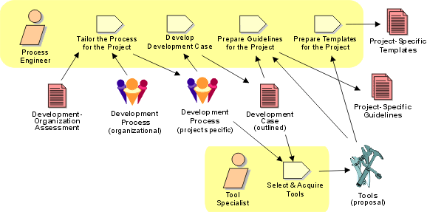
What Is a Workflow?
A meaningful set of activities that produce a useful result (artifact) by the various roles
  Key elements: artifacts, roles, activities
Example: Prepare Environment for Project

Slide 27
Business Modeling Workflow
Understand structure & dynamics of the target organization
Understand current problems in the target organization & identify improvement potential
Ensure customers, end users & developers have common understanding of target organization
Derive system requirements to support target organization

Slide 28
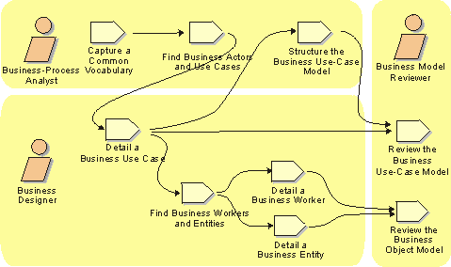
Business Modeling Workflow

Slide 29
Business Modeling Artifacts
Business Vision
Business Architecture Document
Supplementary Business Specification
Business Rules (either as a document and/or as elements in the Business Analysis Model)
Business Glossary

Slide 30
The Requirements Workflow
Goal: determine the client’s needs
1. Gain an understanding of the application domain
  The specific business environment in which the software product is to operate
2. Build a business model
  Use UML to describe the client’s business processes
  If at any time the client does not feel that the cost is justified, development terminates immediately

Slide 31
Determine Client’s Constraints
Deadline
  Software products are often mission critical
Parallel running
Portability
Reliability
Rapid response time
Cost
  The client will rarely inform the developer how much money is available
  A bidding procedure is used instead

Slide 32
The Analysis Workflow
Goal: analyze and refine the requirements
Why not done during the requirements workflow?
  The requirements artifacts must be totally comprehensible by the client.
  The artifacts of the requirements workflow must be expressed in a natural (human) language.
  All natural languages are imprecise.
The analysis artifacts must be precise, and complete enough for the designers.

Slide 33
The Analysis Workflow (contd)
Example from a manufacturing info system:
  “A part record and a plant record are read from the database. If it contains the letter A directly followed by the letter Q, then calculate the cost of transporting that part to that plant”
To what does it refer?
  The part record?
  The plant record?
  Or the database?

Slide 34
Software Project Management Plan
Once the client has signed off the specifications, detailed planning and estimating begins
Draw up the management plan, including
  Cost estimate
  Duration estimate
  Deliverables
  Milestones
  Budget
This is the earliest possible time for the software project management plan

Slide 35
The Design Workflow
Goal: Refine the analysis until the material is in a form that can be implemented by programmers
Many nonfunctional requirements need to be finalized at this time
    Choice of programming language
    Reuse and portability issues
Classes are extracted during the analysis workflow and designed during the design workflow
Retain design decisions to prevent the maintenance team reinventing the wheel

Slide 36
The Implementation Workflow
Goal: Implement the target product in the selected language
  A large product is partitioned into subsystems
  The subsystems consist of components

Slide 37
The Test Workflow
Responsibility of every developer and maintainer, and quality assurance group
  Each component is tested as soon as it has been implemented: Unit testing
  The completed components are combined and tested: Integration testing
  When the product appears to be complete, it is tested as a whole: Product testing
  Once the completed product has been installed on the client’s computer, the client tests it: Acceptance testing
Traceability of artifacts is an important requirement for successful testing

Slide 38
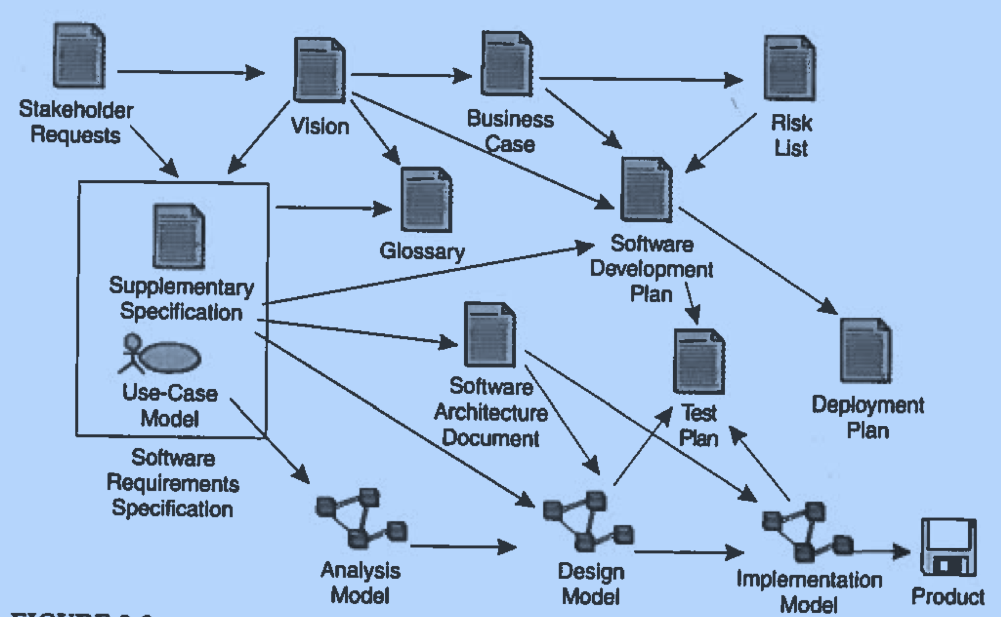
Major Artifacts of Unified Process

Slide 39
Characteristics of Unified Process
Iterative and Incremental
Risk Focused
Use Case Driven
  Use case modeling is understandable to various stakeholders: users, developers, customers
Architecture Centric
  An architecture view is a simplified description of a system from a particular perspective
Notes:
Different blueprints for a building: floor plan, electric cabling, water pipe/central heating/ventilation, the look of the building in its environment

Slide 40
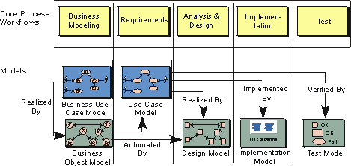
Use Cases in the Process

Slide 41
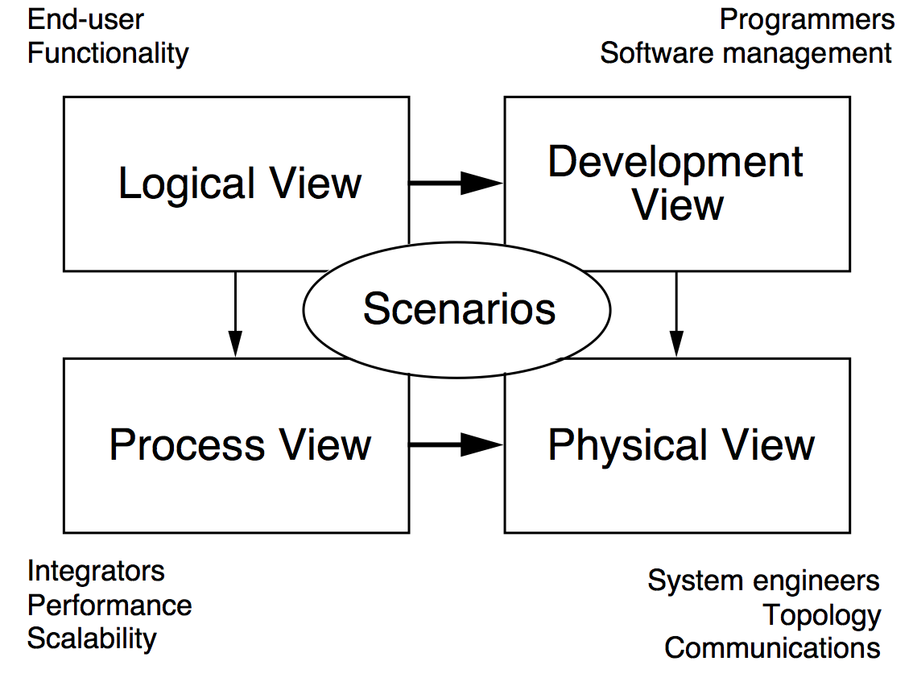
The 4+1 View of Architecture
Use cases
Notes:
Logical view: what the system should do for its end user. Abstraction of the design model with major design packages, subsystems and classes.
Implementation view: organization of static modules – source code, data files, components, executables
Process view: concurrent aspects of the system at runtime – tasks, threads or processes and their interactions.
Deployment view: how the various executables and other runtime components are mapped to the underlying platforms or computing nodes.

Slide 42
Improving the Software Process
The fundamental problem with software
  The software process is badly managed
Software process improvement initiatives
  Capability maturity model (CMM)
  ISO 9000-series
  ISO/IEC 15504

Slide 43
Capability Maturity Models
Not life-cycle models
Rather, a set of strategies for improving the software process
  SW–CMM for software
  P–CMM for human resources (“people”)
  SE–CMM for systems engineering
  IPD–CMM for integrated product development
  SA–CMM for software acquisition
These strategies are unified into CMMI (capability maturity model integration)

Slide 44
SW–CMM
Improving the software process leads to
  Improved software quality
  Delivery on time, within budget
Improved management leads to
  Improved techniques
Five levels of maturity are defined
  Maturity is a measure of the goodness of the process
An organization advances stepwise from level to level

Slide 45
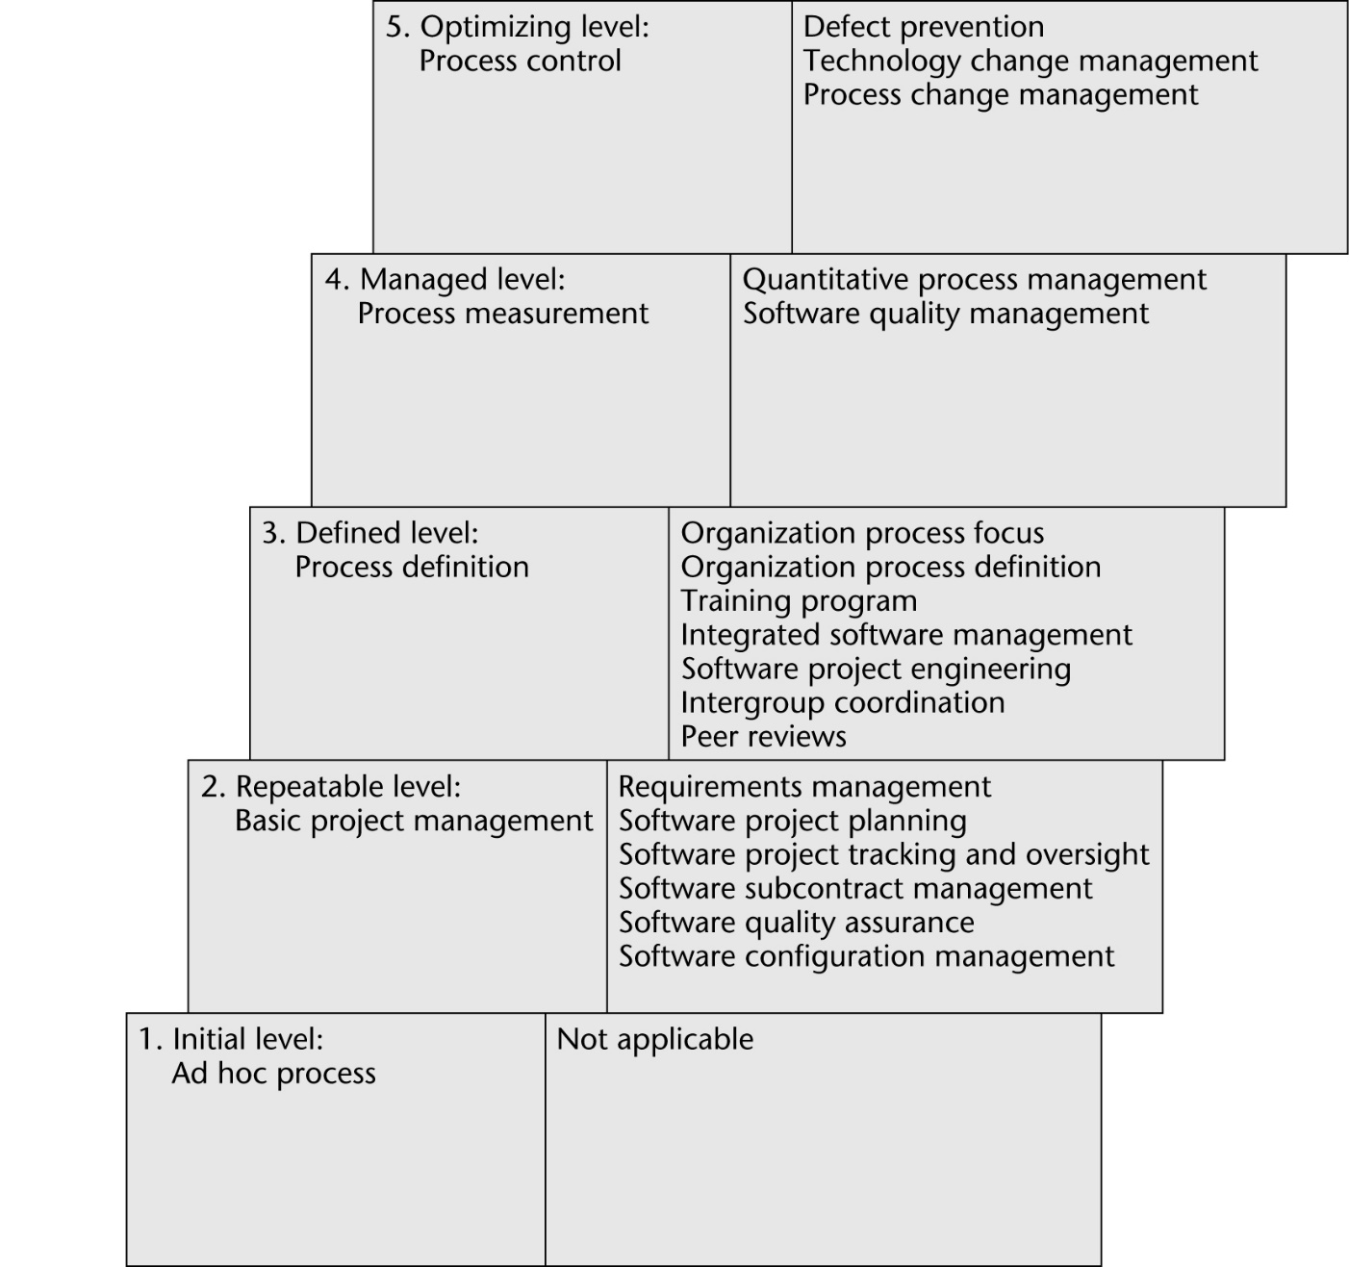
SW-CMM Levels

Slide 46
CMM Levels
Level1: Initial level (ad hoc process)
  The entire process is unpredictable
  Management consists of responses to crises
2: Repeatable level: Basic software management
  Management decisions should be made on the basis of previous experience with similar products
  Measurements (“metrics”) are made
  These can be used for making cost and duration predictions in the next project
  Problems are identified, immediate corrective action is taken

Slide 47
CMM Levels - cont
Level 3. Defined Level
  The software process is fully documented
  Managerial and technical aspects are clearly defined
  Continual efforts to improve quality and productivity
  Reviews are performed to improve software quality
  CASE environments are applicable
Level 4: Managed Level
  Quality and productivity goals are set for each project
  Quality and productivity are continually monitored
  Statistical quality controls are in place

Slide 48
CMM Levels - cont
Level 5. Optimizing Level
  Continuous process improvement
  Statistical quality and process controls
  Feedback of knowledge from each project to the next
Experiences with CMM levels
  It takes 3 to 5 years to get from level 1 to level 2
  1.5 to 3 years from level 2 to level 3
  SEI questionnaires highlight shortcomings, suggest ways to improve the process

Slide 49
ISO 9000
A set of five standards for industrial activities
  ISO 9001 for quality systems
  ISO 9000-3, guidelines to apply ISO 9001 to software
  There is an overlap with CMM, but they are not identical
  Not process improvement
  There is a stress on documenting the process
  There is an emphasis on measurement and metrics
  ISO 9000 is required to do business with the EU
  Also required by many U.S. businesses, including GE
  More and more U.S. businesses are ISO 9000 certified

Slide 50
ISO/IEC 15504
Original name: Software Process Improvement Capability dEtermination (SPICE)
  International process improvement initiative
  Started by the British Ministry of Defence (MOD)
  Includes process improvement, software procurement
  Extends and improves CMM, ISO 9000
  A framework, not a method
    CMM, ISO 9000 conform to this framework
  Now referred to as ISO/IEC 15504
  Or just 15504 for short

Slide 51
Costs and Benefits of Process Improvement
Hughes Aircraft spent $500K (1987–90)
  Savings: $2M per year, moving from level 2 to level 3
Raytheon from level 1 in 1988 to level 3 in 1993
  Productivity doubled
  Return of $7.70 per dollar invested in process improvement
Tata Consultancy Services (India) used ISO 9000 and CMM (1996–90)
  Errors in estimation decreased from 50% to 15%
  Effectiveness of reviews increased from 40% to 80%

Slide 52
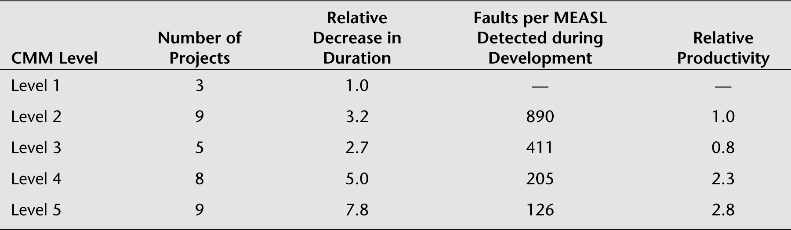
Results of 34 Motorola Projects
MEASL – Million equivalent assembler source lines
Motorola does not reveal productivity data
  Productivity is measured relative to that of a selected level-2 project
  No fault or productivity data available for level-1 projects (by definition)

